Slide 1
Decision Trees The basics
Michael Claudius, Associate Professor, Roskilde

Slide 2
What is decision tree?
A powerful predicative algorithm for classification and regression
Predictions are based on (binary) trees
Root
Nodes (inner nodes and leafs at the bottom)
Leafs are nodes with no children
Classification OR value regression
Training is based on Gini impurity OR entropy
Fundamental component of RandomForest
Give you a minute: Its BCT (Before Corona Times). You and 159 other students wake up in the morning.
How many will be late to school start. What is the probability for a student to be late.
Take train Yes/No. Is Train delayed Yes/No.
Make a tree guessing some numbers for each question. Now you have an idea of the probability for delayed students
So its predicting something; lets look at that !

Slide 3
Evaluation of decision trees?
Advantages
Very good for complex data sets
White box; knows in details how it works
Simple, no feature preparation, no scaling and no centering
Easy to use
Fast prediction, even for huge data sets
Basic component of Random Forest algorithm
Disadvantages
Sensitive to small variations in the training data set => very different models
Sensitive to data set rotation => unnecessary convoluted decision boundaries
Easy to overfit, must adjust for example
maximum depth (i.e. number of levels)
minimum number of samples in a leaf
minimum number of samples in a node before it can split
Slow algorithm for training (which must be stopped)

Slide 4
Choose and build classifier(s)
Find features and make a decision on the split-values
The aim is to find variables and values that split the data into homogenous groups
Minimizing using entropy or Gini-impurity
Let’s see how it looks for the Iris case! But first we watch an easy video introduction Decision Trees Introduction(16 minutes)

Slide 5
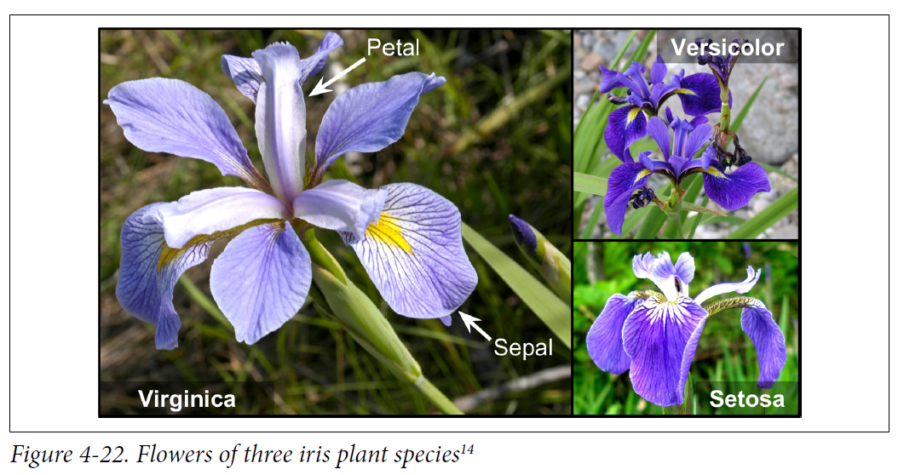
The Iris flower case
Data set with 150 Iris pictures of 3 different species (50 each)

Slide 6
Choose and build classifier(s)
Find features and make a decision on the split-values
The aim is to find variables and values that split the data into homogenous groups
Minimizing using entropy or impurity
The decision tree is based on
Petal length $≤$ 2.45
Petal width $≤$ 1.75
Outcome is Iris Virginica OR Iris Versicolor OR Iris Setosa with probabilities
Using CART training algorithm
Lets see how it looks!

Slide 7
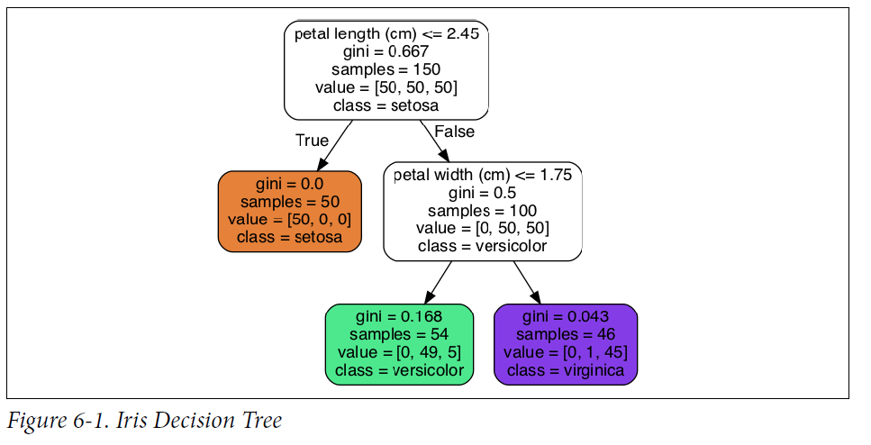
Decision tree for Iris data set
Structure of decision tree

Slide 8
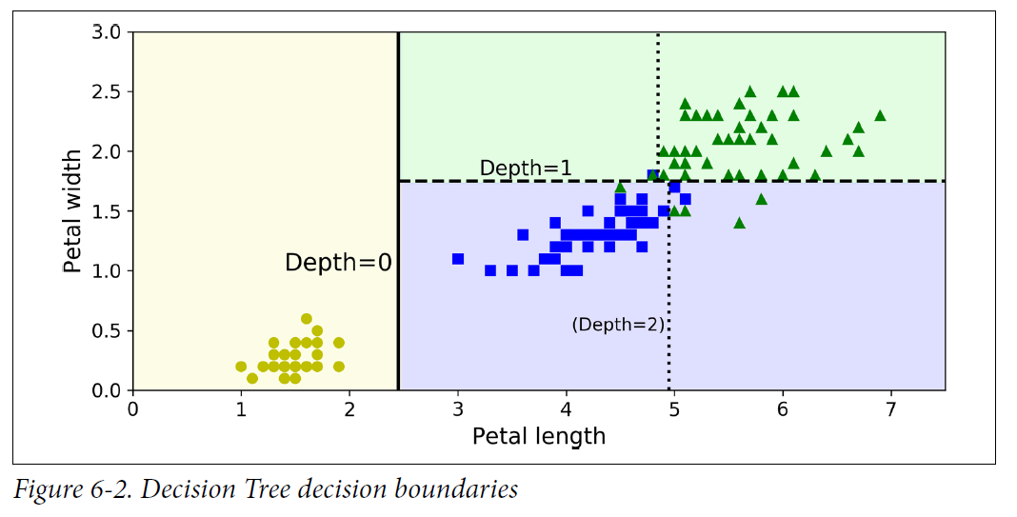
Decison tree decision boundaries
Depending on the depth of tree you get these boundaries

Slide 9
Decision tree for Iris data set
Splitting 150 data by
Petal length $≤$ 2.45
Yes (True): No more split sample size 50 [50,0,0], pure probability 50/50 = 1
No (False): Petal width $≤$ 1.75
Yes: Sample size 54 [0,49,5], some impurity probability 49/54, 5/54
No: Sample size 46 [0,1,45] , small impurity probability 45/46, 1/46
But why 2,45 and 1,75 ? That’s about impurity !

Slide 10
Gini impurity
Like diamonds the more pure the better; so the more homogeneous the better
A node is pure, if all instances belongs to the same class Gini score = 0
Otherwise more or less impure
Impurity is measured by the Gini score G_{i}
Look at figure 6.1.
Depth 2 left node: G_{i} = 1 – (0/54)² - (49/54)² - (5/54)² = 0.168

Slide 11
Training
Idea is to train the model (i.e. changing the structure of the tree)
So need a cost function J( G_{left,} G_{right} ) fulfilling:
Higher impurity => higher costs
Low impurity => low costs
And yes it exists! We are lucky.

Slide 12
CART cost function
Why lucky. It is very simple
How to find the best decision tree? This time we are rather lucky…..

Slide 13
Training average cost function
Why rather lucky?, because procedure is simple, but unfortunately recursive
Split the training set in two sub set using a feature, k, and a threshold t_{k} (a value like: petal length < 2.45)
Searches for the (k, t_{k}) producing the purest subsets (weighted by size / sample number)
Then it splits the subsets using the same logic etc. etc.
That is an endless story so
Stop when
maximum depth (e.g. 3 in Iris example) is reached
OR if a split does not reduce impurity/entropy
OR few items in a leaf (10%, 20%..?)
OR all items in one binary leaf….?
Recursion is greedy (time/memory consuming), so we will have to stop when the solution is “good” enough
(BAM)

Slide 14
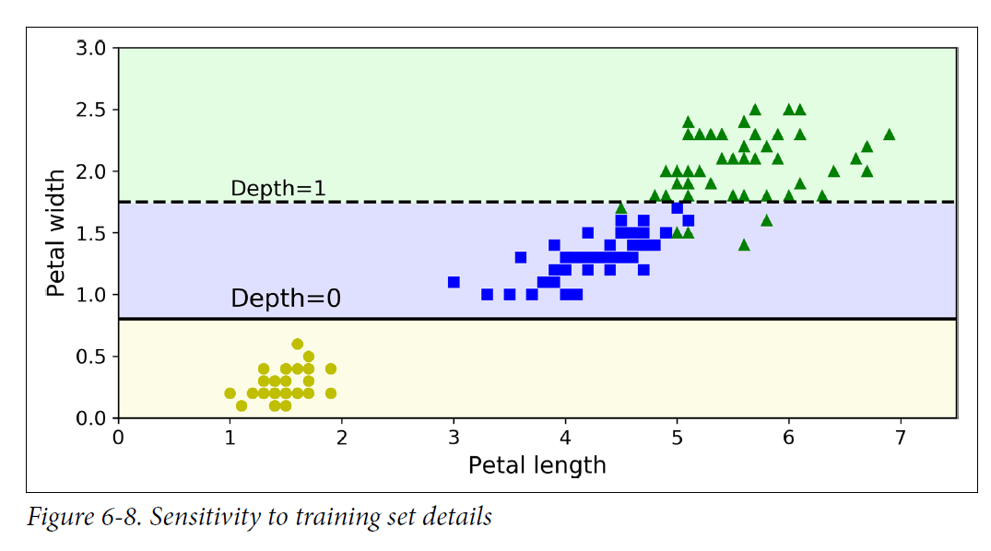
Decison tree sensivity
Change the data a little and then you get these very different boundaries !

Slide 15
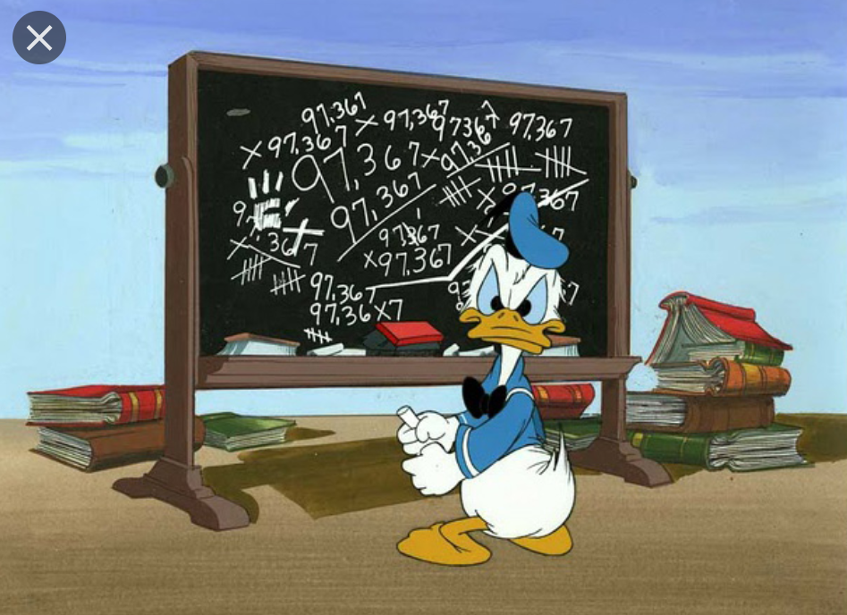
Assignments
It is time for discussion and solving a few assignments in groups
Decision Trees Questions Chapter 6

